Slide 1
Global Population and GDP Analysis
Sakthivel p

Slide 2
Overview
This project analyzes global population and economic trends using multiple datasets covering population, GDP, literacy, infant mortality, and regional characteristics.
SQL Database:
  Countries world
Excel Files:
  Population data (1960–2017)
  GDP data (1960–2016)
  Country metadata (region, income group)
Tools used:
  Power BI
  Power Query for data cleaning
  DAX for calculated measures (CAGR, GDP per capita, rankings)

Slide 3
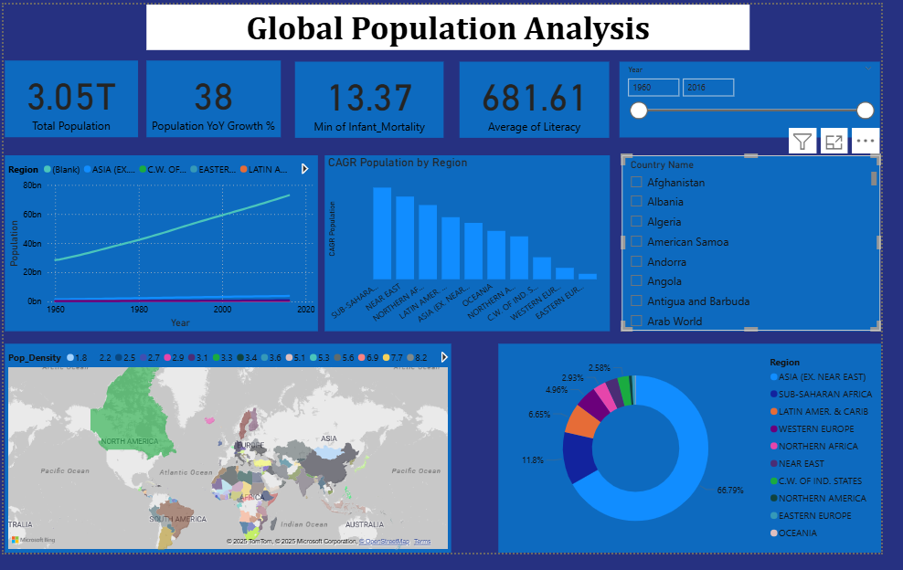

Global Population Overview
Content:
Global population has increased steadily over time.
Population growth is uneven across regions.
Asia contributes the largest share of global population.
Africa shows rapid population expansion.

Slide 4
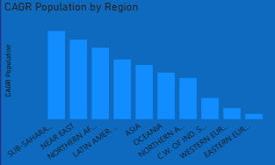
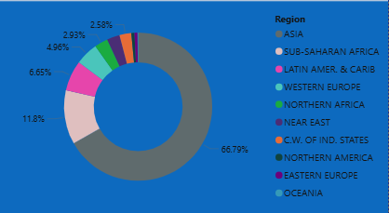
Population Growth by Region
Content:
Sub-Saharan Africa has the highest population CAGR.
Asia shows sustained long-term population growth.
Europe and North America display low or stagnant growth due to aging populations.

Slide 5
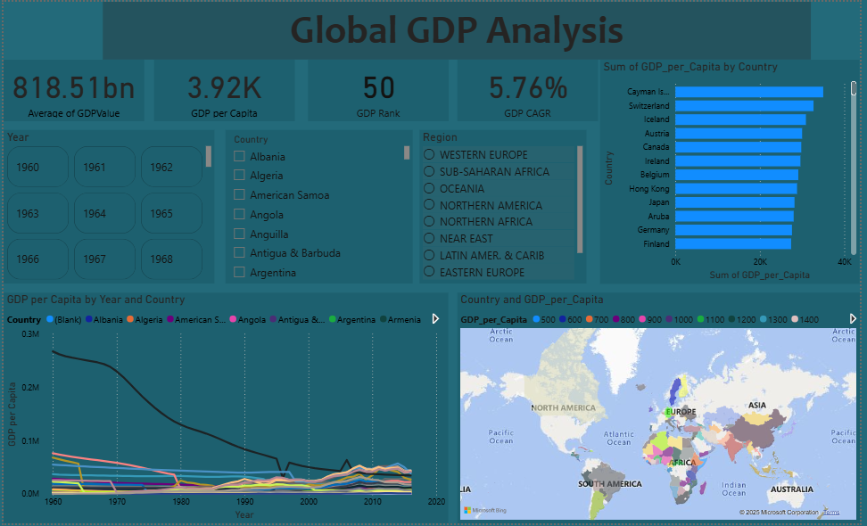
Global GDP Overview
Content:
Global GDP shows steady long-term growth.
GDP per capita varies significantly across countries.
High GDP does not always imply high GDP per capita.

Slide 6
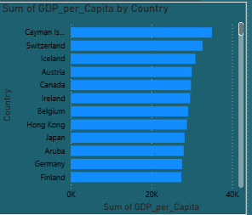
GDP per Capita Analysis
Content:
Countries like Switzerland, Iceland, and Canada rank high in GDP per capita.
Smaller economies can outperform larger ones in per-capita wealth.
GDP Rank dynamically shows each country’s relative economic position.

Slide 7
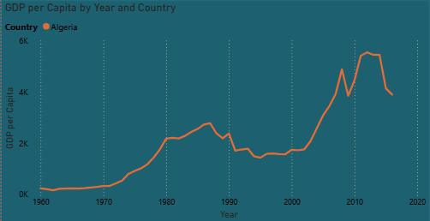
GDP Growth Trends
Content:
Global GDP CAGR indicates moderate and stable economic growth.
Developing economies show faster growth rates.
Developed economies show stable but slower growth.

Slide 8
Population vs GDP
Content:
High population growth regions often have lower GDP per capita.
Economically developed regions tend to have slower population growth.
Literacy and education act as a bridge between population growth and economic development.

Slide 9
Thank you

